Slide 1


DIGITAL CLOCK
Using 8051 microcontroller and DS1307
~ V Jahnavika Reddy

Slide 2
INTRODUCTION:
The Digital Clock using the 8051 microcontroller and DS1307 real-time clock is a project that combines embedded systems and real-time clock technology. This project involves interfacing an 8051 microcontroller with the DS1307 RTC module to accurately display and maintain the current time on a 16x2 LCD display. The microcontroller is programmed to communicate with the RTC module using the I2C protocol, fetch the time information, and then format and display it on the LCD. Additionally, the project typically includes functionality for setting the time using the code, providing a hands-on learning experience in microcontroller programming and hardware interfacing.

Slide 3
Components used:
8051 microcontroller
DS1307 RTC module
Jumper wires
LCD display
3V battery
Resisters

Slide 4
Block Diagram:
keil
8051 microcontroller
LCD display
DS1307

Slide 5
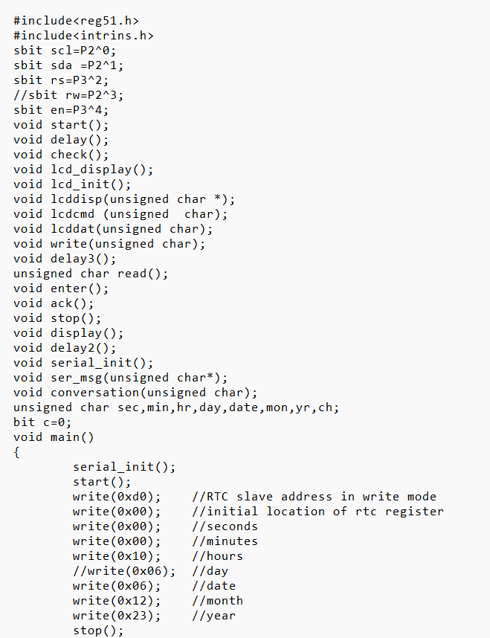
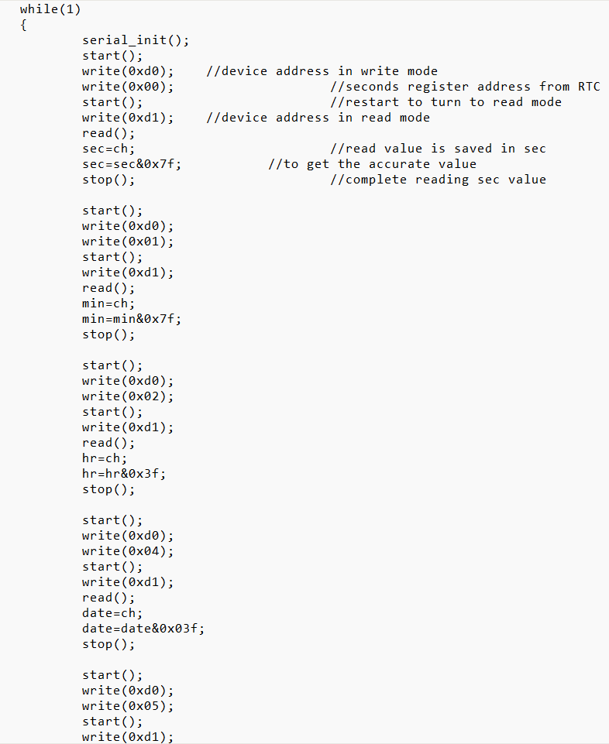
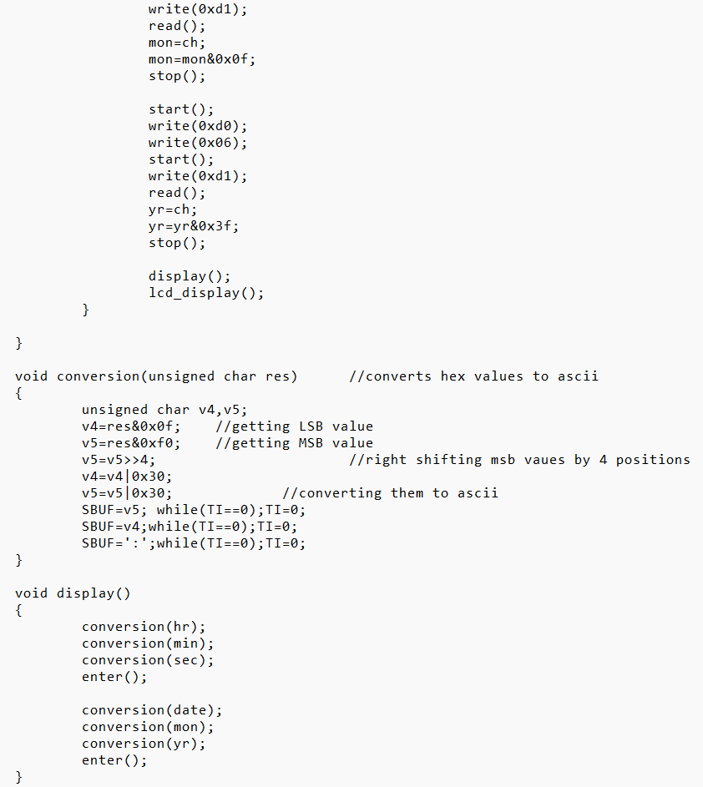
Code :

Slide 6
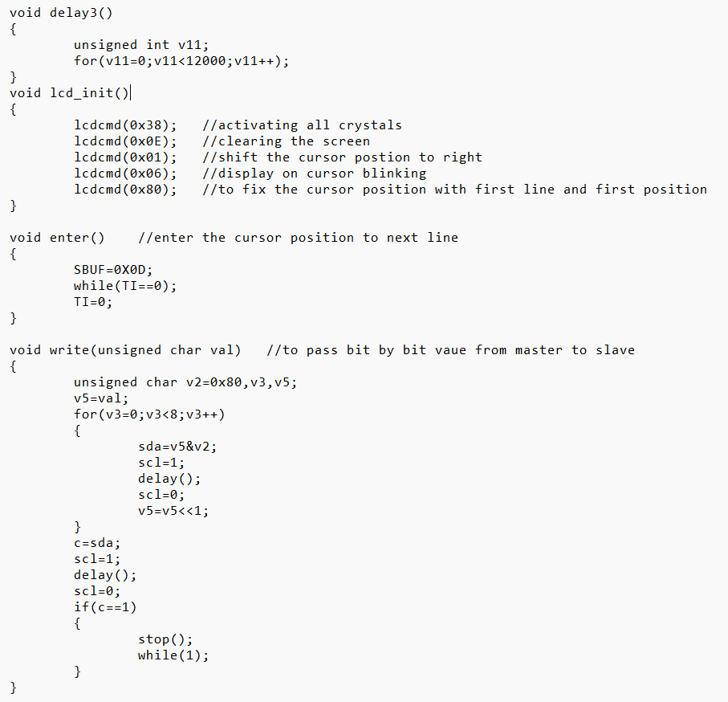
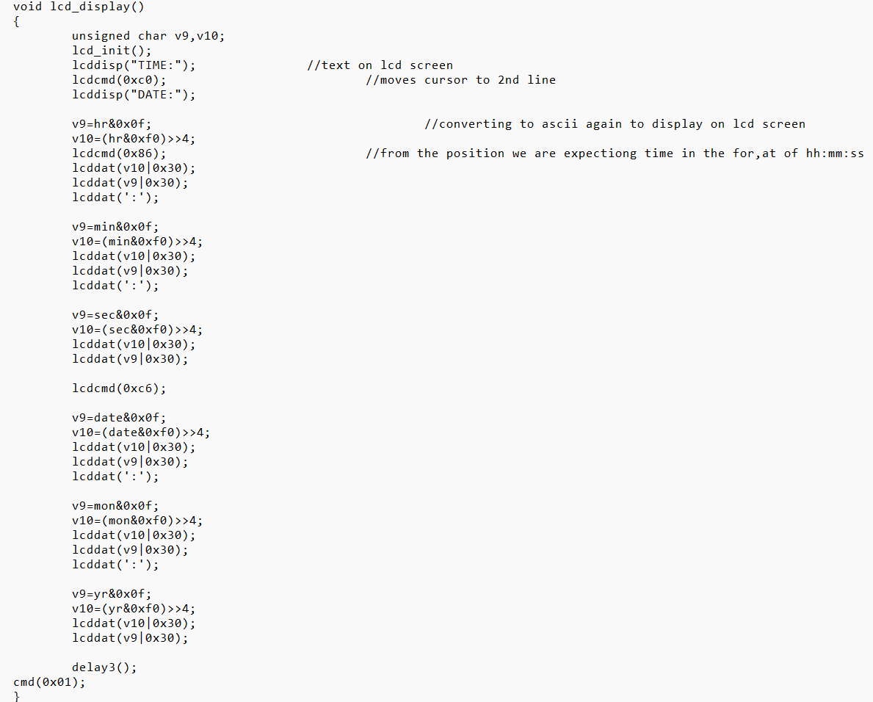
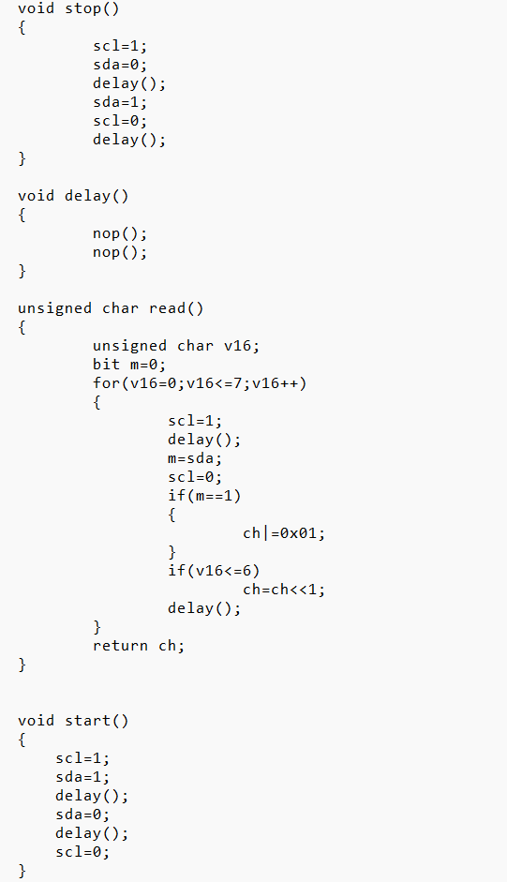
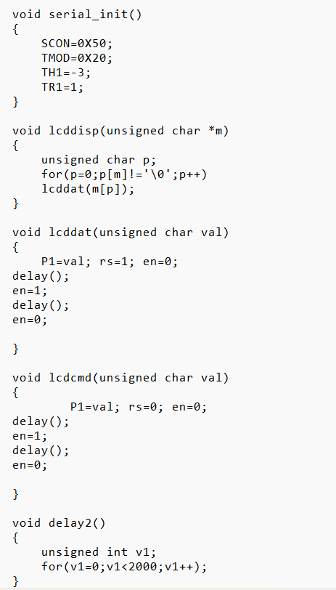
Code(cont..)

Slide 7
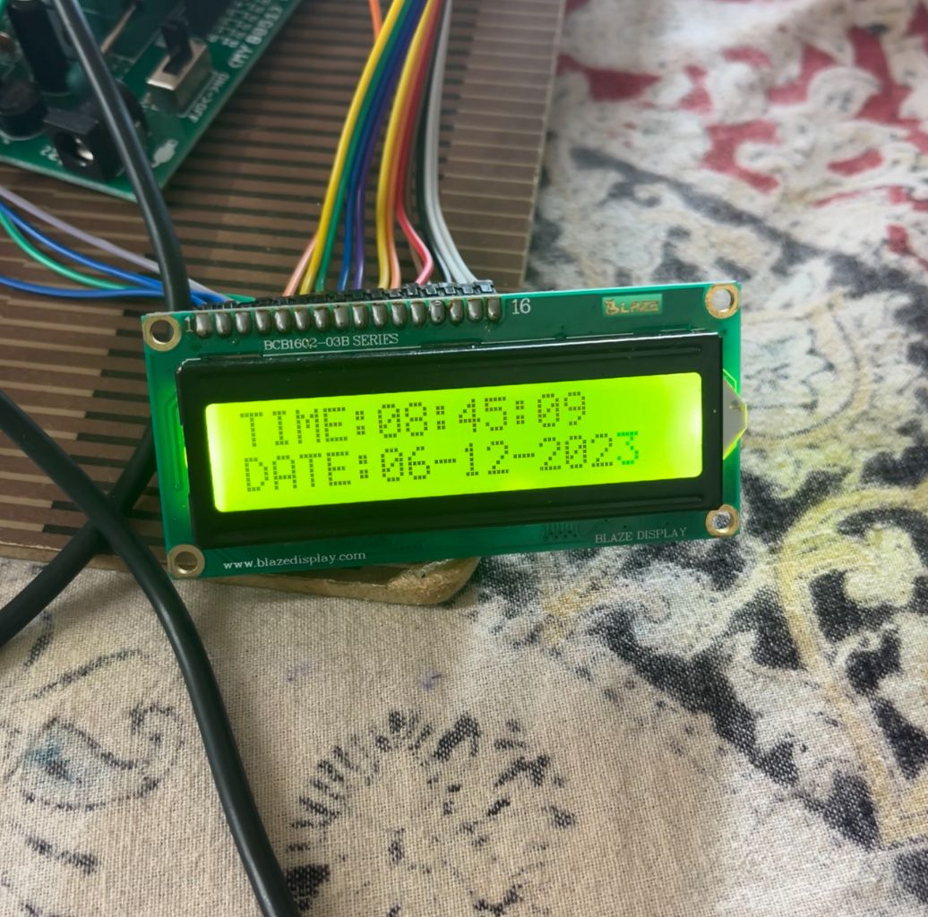
Working principle
We have used 8051 micro controller and ds1307 rtc module to display the the time and date on lcd display. We have used embedded c language for this project in keil software . we used I2C protocol for interfacing the rtc module and microcontroller.

Slide 8
Thank you

